Slide 1


Methods
Chris Piech
CS106A, Stanford University
This is Method Man. He is part of the Wu Tang Clan. ☺

Slide 2
Civilization advances by extending the number of operations we can perform without thinking about them.
-Alfred North Whitehead

Slide 3
Calling Methods
turnRight();
move();
readInt(“Int please! ”);
println(“hello world”);
rect.getX();
drawRobotFace();
rect.setLocation(10, 20);
preventGlobalWarming();

Slide 4

Defining a Method
private void turnRight() {
turnLeft();
turnLeft();
turnLeft();
}

Slide 5

Learn How To
Write a method that takes in input
Write a method that gives back output
Trace method calls using stacks

Slide 6
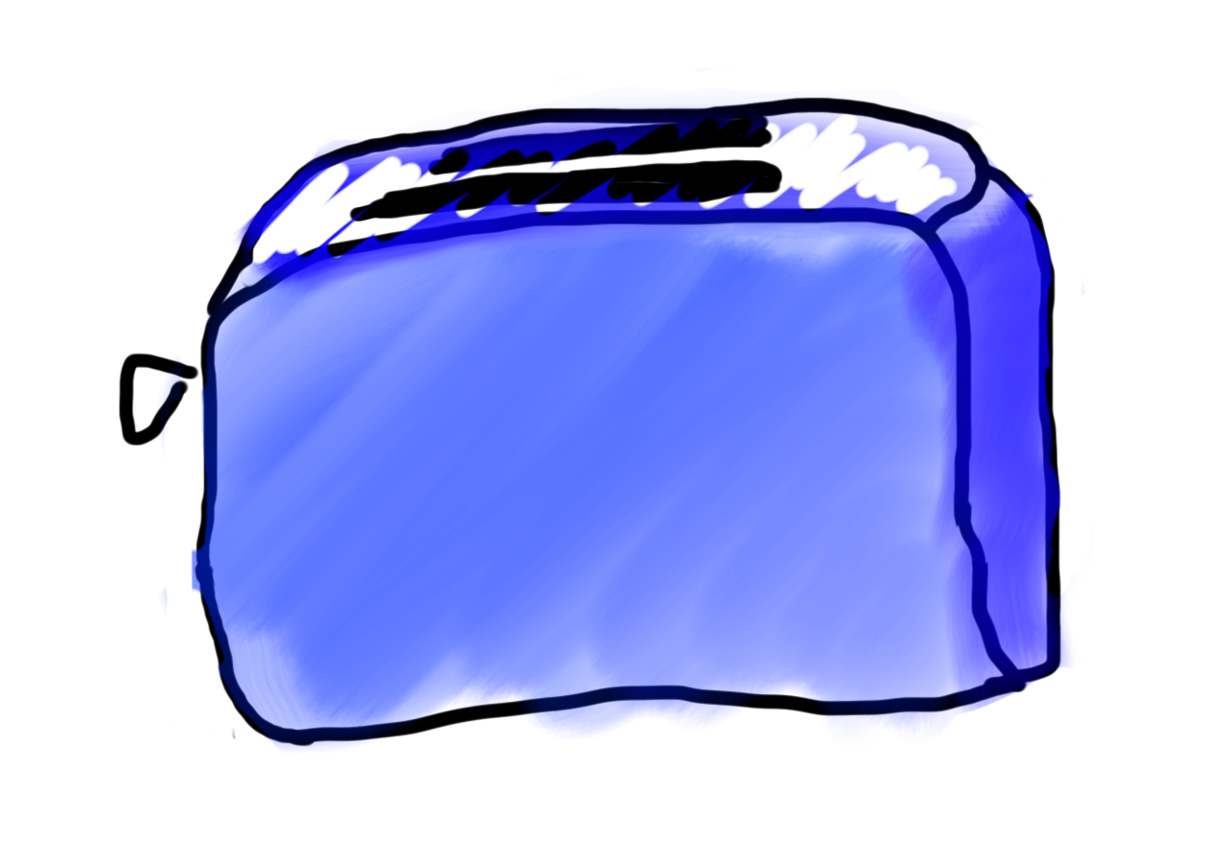
Methods are Like Toasters

Slide 7
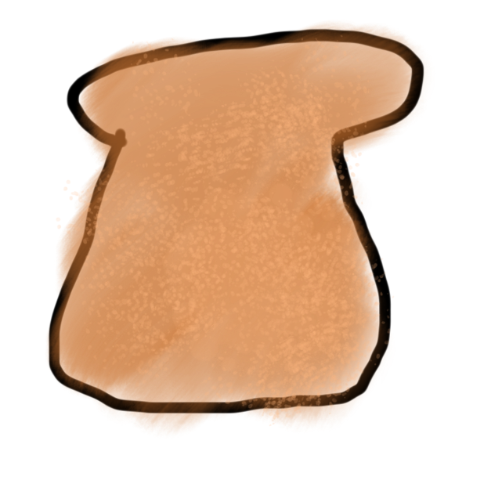
Methods are Like Toasters
parameter

Slide 8

Methods are Like Toasters
parameter

Slide 9
Methods are Like Toasters

Slide 10

Methods are Like Toasters

Slide 11
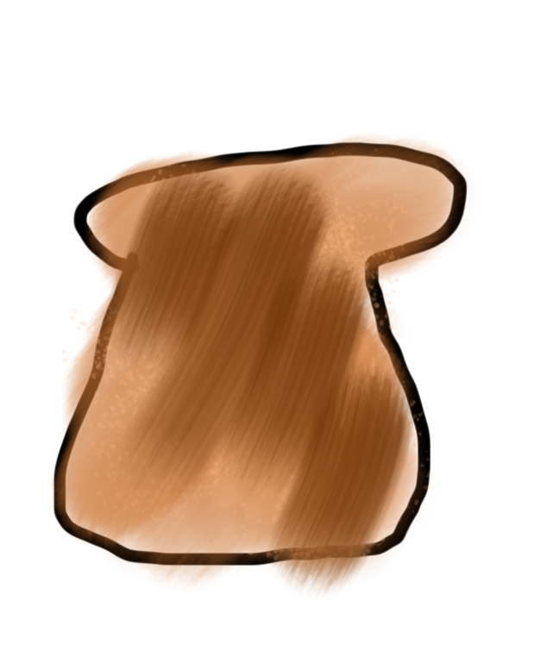
Methods are Like Toasters
return

Slide 12
Methods are Like Toasters

Slide 13

Methods are Like Toasters

Slide 14
Methods are Like Toasters

Slide 15

Methods are Like Toasters

Slide 16
Methods are Like Toasters

Slide 17
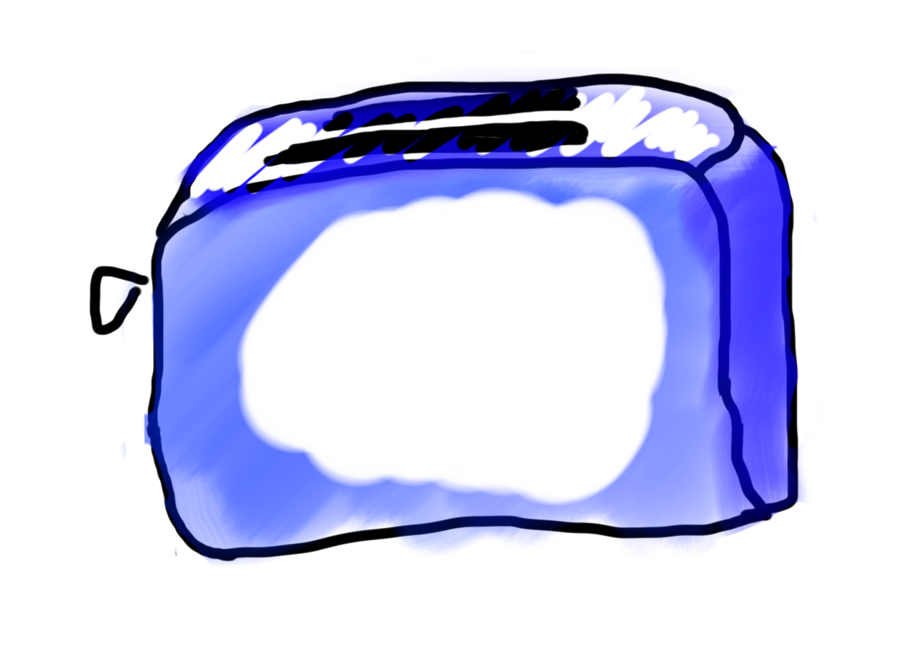
Methods are Like Toasters

Slide 18
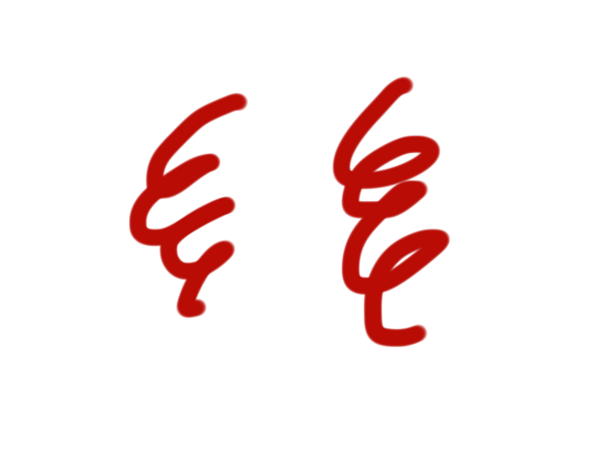
Methods are Like Toasters

Slide 19

Methods are Like Toasters

Slide 20
Methods are Like Toasters
parameter(s)
return

Slide 21
Anatomy of a method
public void run() {
double mid = average(5.0, 10.2);
println(mid);
}
private double average(double a, double b) {
double sum = a + b;
return sum / 2;
}

Slide 22
Anatomy of a method
public void run() {
double mid = average(5.0, 10.2);
println(mid);
}
private double average(double a, double b) {
double sum = a + b;
return sum / 2;
}
method “definition”

Slide 23
Anatomy of a method
public void run() {
double mid = average(5.0, 10.2);
println(mid);
}
private double average(double a, double b) {
double sum = a + b;
return sum / 2;
}
Output expected
Input expected

Slide 24
Anatomy of a method
public void run() {
double mid = average(5.0, 10.2);
println(mid);
}
private double average(double a, double b) {
double sum = a + b;
return sum / 2;
}
name

Slide 25
Anatomy of a method
public void run() {
double mid = average(5.0, 10.2);
println(mid);
}
private double average(double a, double b) {
double sum = a + b;
return sum / 2;
}
body

Slide 26
Anatomy of a method
public void run() {
double mid = average(5.0, 10.2);
println(mid);
}
private double average(double a, double b) {
double sum = a + b;
return sum / 2;
}
return

Slide 27
Anatomy of a method
public void run() {
double mid = average(5.0, 10.2);
println(mid);
}
private double average(double a, double b) {
double sum = a + b;
return sum / 2;
}
method “call”

Slide 28
Defining a Method
visibility type nameOfMethod(parameters) {
statements
}
visibility: usually private or public
type: type returned by method (e.g., int , double, etc.)
Can be void to indicate that nothing is returned
parameters: information passed into method

Slide 29

Learn by Example

Slide 30
Void Example
private void printIntro() {
println("Welcome to class");
println("It's the best part of my day.");
}
public void run() {
printIntro();
}

Slide 31
Parameter and Return Example
private double metersToCm(double meters) {
return 100 * meters;
}
public void run() {
println(metersToCm(5.2));
}

Slide 32
Parameter Example
private void printOpinion(int num) {
if(num == 5) {
println(“I love 5!”);
} else {
println(“Whattever”);
}
}
public void run() {
printOpinion(5);
}

Slide 33
Multiple Parameters
private void max(int num1, int num2) {
if(num1 >= num2) {
return num1;
}
return num2;
}
public void run() {
printOpinion(5);
}

Slide 34
Multiple Parameters
private void max(int num1, int num2) {
if(num1 >= num2) {
return num1;
}
return num2;
}
public void run() {
printOpinion(5);
}

Slide 35
Passing in Classes

Slide 36
A Full Program
public class FactorialExample extends ConsoleProgram {
private static final int MAX_NUM = 4;
public void run() {
for(int i = 0; i < MAX_NUM; i++) {
println(i + "! = " + factorial(i));
}
}
private int factorial(int n) {
int result = 1;
for (int i = 1; i <= n; i++) {
result *= i;
}
return result;
}
}

Slide 37
A Full Program
public class FactorialExample extends ConsoleProgram {
private static final int MAX_NUM = 4;
public void run() {
for(int i = 0; i < MAX_NUM; i++) {
println(i + "! = " + factorial(i));
}
}
private int factorial(int n) {
int result = 1;
for (int i = 1; i <= n; i++) {
result *= i;
}
return result;
}
}

Slide 38
Understand the Mechanism

Slide 39
public void run() {
for(int i = 0; i < MAX_NUM; i++) {
println(i + "! = " + factorial(i));
}
}
i

Slide 40
public void run() {
for(int i = 0; i < MAX_NUM; i++) {
println(i + "! = " + factorial(i));
}
}
i
0

Slide 41
public void run() {
for(int i = 0; i < MAX_NUM; i++) {
println(i + "! = " + factorial(i));
}
}
i
0

Slide 42
public void run() {
for(int i = 0; i < MAX_NUM; i++) {
println(i + "! = " + factorial(i));
}
}
i
0

Slide 43
public void run() {
for(int i = 0; i < MAX_NUM; i++) {
println(i + "! = " + factorial(i));
}
}
i
0

Slide 44
public void run() {
for(int i = 0; i < MAX_NUM; i++) {
println(i + "! = " + factorial(i));
}
}
private int factorial(int n) {
int result = 1;
for (int i = 1; i <= n; i++) {
result *= i;
}
return result;
}
0
i
n
0
result
i

Slide 45
public void run() {
for(int i = 0; i < MAX_NUM; i++) {
println(i + "! = " + factorial(i));
}
}
private int factorial(int n) {
int result = 1;
for (int i = 1; i <= n; i++) {
result *= i;
}
return result;
}
0
i
n
0
1
result
i

Slide 46
public void run() {
for(int i = 0; i < MAX_NUM; i++) {
println(i + "! = " + factorial(i));
}
}
private int factorial(int n) {
int result = 1;
for (int i = 1; i <= n; i++) {
result *= i;
}
return result;
}
0
i
n
0
1
1
result
i

Slide 47
public void run() {
for(int i = 0; i < MAX_NUM; i++) {
println(i + "! = " + factorial(i));
}
}
private int factorial(int n) {
int result = 1;
for (int i = 1; i <= n; i++) {
result *= i;
}
return result;
}
0
i
n
0
1
1
result
i

Slide 48
public void run() {
for(int i = 0; i < MAX_NUM; i++) {
println(i + "! = " + factorial(i));
}
}
private int factorial(int n) {
int result = 1;
for (int i = 1; i <= n; i++) {
result *= i;
}
return result;
}
0
i
n
0
1
1
result
i

Slide 49
public void run() {
for(int i = 0; i < MAX_NUM; i++) {
println(i + "! = " + factorial(i));
}
}
1
i
0

Slide 50
public void run() {
for(int i = 0; i < MAX_NUM; i++) {
println(i + "! = " + factorial(i));
}
}
1
i
0
0! = 1

Slide 51
public void run() {
for(int i = 0; i < MAX_NUM; i++) {
println(i + "! = " + factorial(i));
}
}
i
1
0! = 1

Slide 52
public void run() {
for(int i = 0; i < MAX_NUM; i++) {
println(i + "! = " + factorial(i));
}
}
i
1
0! = 1

Slide 53
public void run() {
for(int i = 0; i < MAX_NUM; i++) {
println(i + "! = " + factorial(i));
}
}
i
1
0! = 1

Slide 54
public void run() {
for(int i = 0; i < MAX_NUM; i++) {
println(i + "! = " + factorial(i));
}
}
i
1
0! = 1

Slide 55
public void run() {
for(int i = 0; i < MAX_NUM; i++) {
println(i + "! = " + factorial(i));
}
}
private int factorial(int n) {
int result = 1;
for (int i = 1; i <= n; i++) {
result *= i;
}
return result;
}
0
i
n
1
result
i
0! = 1

Slide 56
public void run() {
for(int i = 0; i < MAX_NUM; i++) {
println(i + "! = " + factorial(i));
}
}
private int factorial(int n) {
int result = 1;
for (int i = 1; i <= n; i++) {
result *= i;
}
return result;
}
0
i
n
1
1
result
i
0! = 1

Slide 57
public void run() {
for(int i = 0; i < MAX_NUM; i++) {
println(i + "! = " + factorial(i));
}
}
private int factorial(int n) {
int result = 1;
for (int i = 1; i <= n; i++) {
result *= i;
}
return result;
}
0
i
n
1
1
1
result
i
0! = 1

Slide 58
public void run() {
for(int i = 0; i < MAX_NUM; i++) {
println(i + "! = " + factorial(i));
}
}
private int factorial(int n) {
int result = 1;
for (int i = 1; i <= n; i++) {
result *= i;
}
return result;
}
0
i
n
1
1
1
result
i
0! = 1

Slide 59
public void run() {
for(int i = 0; i < MAX_NUM; i++) {
println(i + "! = " + factorial(i));
}
}
private int factorial(int n) {
int result = 1;
for (int i = 1; i <= n; i++) {
result *= i;
}
return result;
}
0
i
n
1
1
1
result
i
0! = 1

Slide 60
public void run() {
for(int i = 0; i < MAX_NUM; i++) {
println(i + "! = " + factorial(i));
}
}
private int factorial(int n) {
int result = 1;
for (int i = 1; i <= n; i++) {
result *= i;
}
return result;
}
0
i
n
1
1
2
result
i
0! = 1

Slide 61
public void run() {
for(int i = 0; i < MAX_NUM; i++) {
println(i + "! = " + factorial(i));
}
}
private int factorial(int n) {
int result = 1;
for (int i = 1; i <= n; i++) {
result *= i;
}
return result;
}
0
i
n
1
1
2
result
i
0! = 1

Slide 62
public void run() {
for(int i = 0; i < MAX_NUM; i++) {
println(i + "! = " + factorial(i));
}
}
private int factorial(int n) {
int result = 1;
for (int i = 1; i <= n; i++) {
result *= i;
}
return result;
}
0
i
n
1
1
2
result
i
0! = 1

Slide 63
public void run() {
for(int i = 0; i < MAX_NUM; i++) {
println(i + "! = " + factorial(i));
}
}
1
i
1
0! = 1

Slide 64
public void run() {
for(int i = 0; i < MAX_NUM; i++) {
println(i + "! = " + factorial(i));
}
}
1
i
1
0! = 1
1! = 1

Slide 65
public void run() {
for(int i = 0; i < MAX_NUM; i++) {
println(i + "! = " + factorial(i));
}
}
i
2
0! = 1
1! = 1

Slide 66
public void run() {
for(int i = 0; i < MAX_NUM; i++) {
println(i + "! = " + factorial(i));
}
}
i
2
0! = 1
1! = 1

Slide 67
public void run() {
for(int i = 0; i < MAX_NUM; i++) {
println(i + "! = " + factorial(i));
}
}
i
2
0! = 1
1! = 1

Slide 68
public void run() {
for(int i = 0; i < MAX_NUM; i++) {
println(i + "! = " + factorial(i));
}
}
i
2
0! = 1
1! = 1

Slide 69
public void run() {
for(int i = 0; i < MAX_NUM; i++) {
println(i + "! = " + factorial(i));
}
}
2
i
2
0! = 1
1! = 1

Slide 70
public void run() {
for(int i = 0; i < MAX_NUM; i++) {
println(i + "! = " + factorial(i));
}
}
2
i
2
0! = 1
1! = 1
2! = 2

Slide 71
public void run() {
for(int i = 0; i < MAX_NUM; i++) {
println(i + "! = " + factorial(i));
}
}
i
3
0! = 1
1! = 1
2! = 2

Slide 72
public void run() {
for(int i = 0; i < MAX_NUM; i++) {
println(i + "! = " + factorial(i));
}
}
i
3
0! = 1
1! = 1
2! = 2

Slide 73
public void run() {
for(int i = 0; i < MAX_NUM; i++) {
println(i + "! = " + factorial(i));
}
}
i
3
0! = 1
1! = 1
2! = 2

Slide 74
public void run() {
for(int i = 0; i < MAX_NUM; i++) {
println(i + "! = " + factorial(i));
}
}
i
3
0! = 1
1! = 1
2! = 2

Slide 75
public void run() {
for(int i = 0; i < MAX_NUM; i++) {
println(i + "! = " + factorial(i));
}
}
6
i
3
0! = 1
1! = 1
2! = 2

Slide 76
public void run() {
for(int i = 0; i < MAX_NUM; i++) {
println(i + "! = " + factorial(i));
}
}
6
i
3
0! = 1
1! = 1
2! = 2
3! = 6

Slide 77
public void run() {
for(int i = 0; i < MAX_NUM; i++) {
println(i + "! = " + factorial(i));
}
}
i
4
0! = 1
1! = 1
2! = 2
3! = 6

Slide 78
public void run() {
for(int i = 0; i < MAX_NUM; i++) {
println(i + "! = " + factorial(i));
}
}
i
4
0! = 1
1! = 1
2! = 2
3! = 6

Slide 79
Bad Times With Methods
// NOTE: This program is buggy!!
private void addFive(int x) {
x += 5;
}
public void run() {
int x = 3;
addFive(x);
println("x = " + x);
}

Slide 80
Good Times With Methods
// NOTE: This program is feeling just fine...
private int addFive(int x) {
x += 5;
return x;
}
public void run() {
int x = 3;
x = addFive(x);
println("x = " + x);
}

Slide 81
Variables are not passed!
Values are passed.

Slide 82
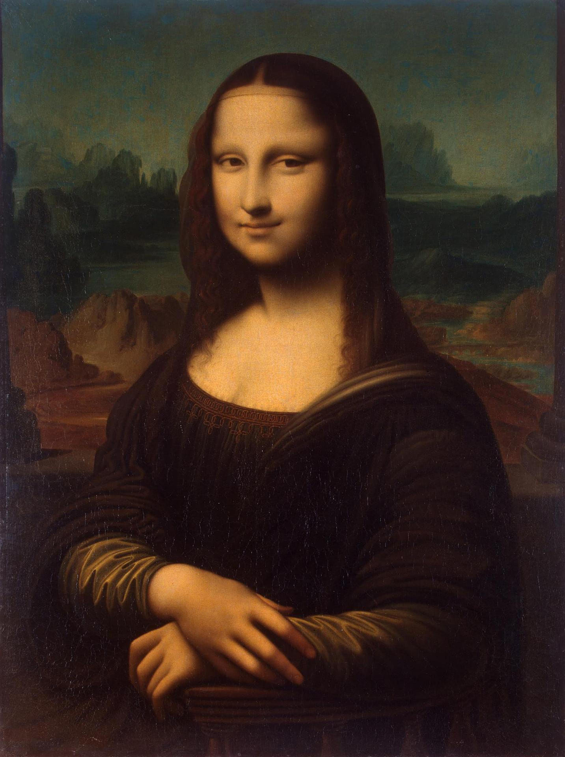
Pass by “Value”

Slide 83
More Examples

Slide 84
Changed Name
private void run() {
int num = 5;
cow(num);
}
private void cow(int grass) {
println(grass);
}

Slide 85
Same Variable
private void run() {
int num = 5;
cow();
}
private void cow() {
int num = 10;
println(num);
}

Slide 86
Methods Called on Objects
GRect rect = new GRect(20, 20);
rect.setColor(Color.Blue);
receiver
* We will talk about how to define these later in the class

Slide 87
Remember Booleans?

Slide 88

Boolean

Slide 89
Boolean Variable
boolean karelIsAwesome = true;
boolean myBool = 1 < 2;

Slide 90
Boolean Operations
boolean a = true;
boolean b = false;
boolean and = a && b;
boolean or = a || b;
boolean not = !a;

Slide 91
Boolean Operations
boolean a = true;
boolean b = false;
boolean and = a && b;
boolean or = a || b;
boolean not = !a;

Slide 92
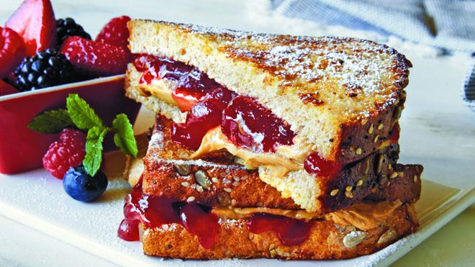

Slide 93
Is Divisible By
private void run() {
for(int i = 1; i <= 100; i++) {
if(isDivisibleBy(i, 7)) {
println(i);
}
}
}

Slide 94

Boolean Return
private void run() {
for(int i = 1; i <= 100; i++) {
if(isDivisibleBy(i, 7)) {
println(i);
}
}
}
private void isDivisibleBy(int a, int b) {
if((a % b) == 0) {
return true;
} else {
return false;
}
}

Slide 95
private void run() {
for(int i = 1; i <= 100; i++) {
if(isDivisibleBy(i, 7)) {
println(i);
}
}
}
private void isDivisibleBy(int a, int b) {
return a % b == 0;
}
Boolean Return

Slide 96
Learn How To
Write a method that takes in input
Write a method that gives back output
Trace method calls using stacks

Slide 97

Extra Exercise
Greek mathematicians took a special interest in numbers that are equal to the sum of their proper divisors (a proper divisor of n is any divisor less than n itself). They called such numbers perfect numbers. For example, 6 is a perfect number because it is the sum of 1, 2, and 3, which are the integers less than 6 that divide evenly into 6. Similarly, 28 is a perfect number because it is the sum of 1, 2, 4, 7, and 14.
For the rest of this class, we’re going to design and implement a Java program that finds all the perfect numbers between two limits. For example, if the limits are 1 and 10000, the output should look like this:
FindPerfect
The perfect numbers between 1 and 10000 are:
6
28
496
8128

